Slide 1

ELE655 Final Project Sound Classification and Distance Prediction
Mustafa Oztoprak
Advisor:Lichuan Liu

Slide 2
Goal
Predict the correct class of an audio sample
Predict the distance from the source audio
Notes:
MFCC features represent phonemes (distinct units of sound) as the shape of the vocal tract (which is responsible for sound generation) is manifest in them.

Slide 3
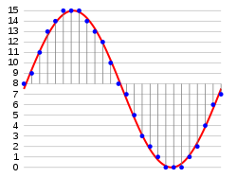
Pulse-code modulation (PCM)
Storing analog audio signal requires it to be digitized by applying sampling and quantization.
PCM, on the other hand, stores uncompressed audio signals.
Source image: https://en.wikipedia.org/wiki/Pulse-code_modulation
Notes:
Sampling refers to measuring the signal values at specific timesteps, which transforms the original time-continuous signal into a time-discrete one. Quantization implies mapping the continuous signal values to discrete values in a specific range, e.g. 16 bits.
EACH TIME STEP STORES A PAM VALUE, which is just the value of the x-axis. Pulse-amplitude modulation.
PCM in the form of binary digits.

Slide 4
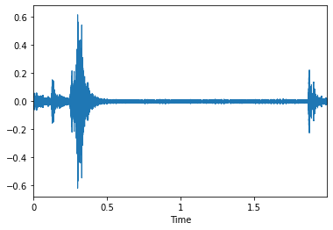
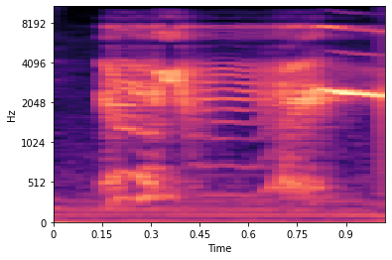
Raw Audio
Mel Spectrogram
Notes:
Telephone, radio sound
A spectrogram is a visualiziaton of the frequency spectrum of a signal over time. The frequency spectrum represents the signal strength of the various frequencies present in the signal. It can be calculated by applying a fourier transform to the signal. The spectogram is depicted as a heat map, which means the intensity at a specific frequency and time is expressed through the color.

Slide 5
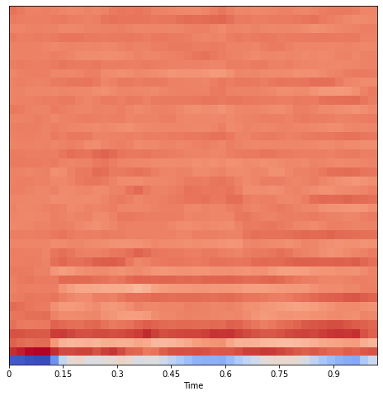
Notes:
To get MFCC, compute the DCT(Discrete Cosine Transform) on the mel-spectrogram. The mel-spectrogram is often log-scaled before. mel-frequency cepstrum is a representation of the short-term power spectrum of a sound

Slide 6
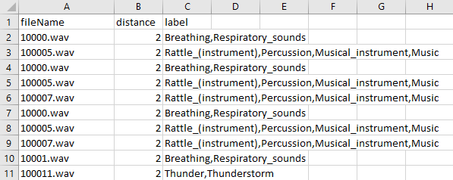
Dataset
FSD50k Zenodo
FSD50k Zenodo modified
Notes:
While the FSD50k dataset has plenty of sound samples, it cannot be used for distance predictions on it's own. Using the FSD50k dataset, we recorded approximately 3000 audio samples from different distances in one room. Note that the room would not be isolated from sound, and background noise would be added for extra challenge.

Slide 7
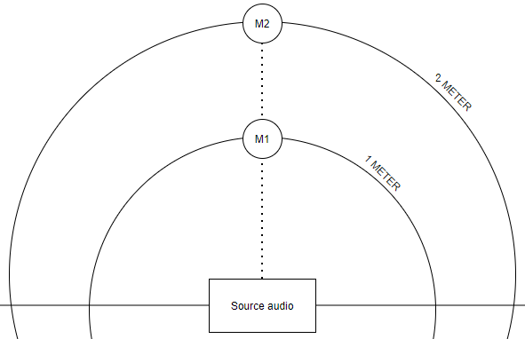

Slide 8
Classification Model
Use Librosa to load individual files
Use Librosa to extract MFCC features
Expand dimensions for a Convolution Network
Notes:
This classification model was inspired by a popular kaggle blog called “Beginner’s Guide to Audio Data”.

Slide 9
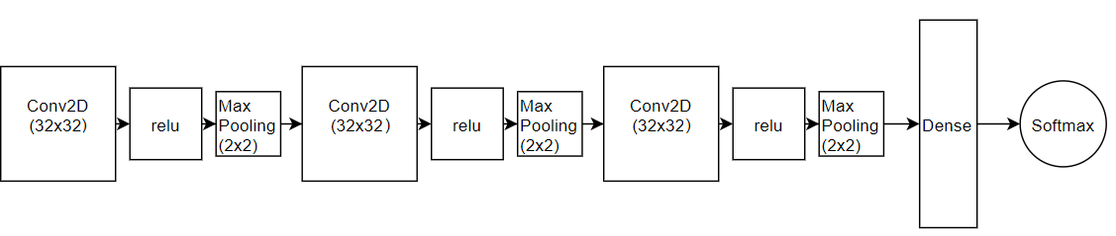
CNN model
Notes:
At first it was tested the normal single label files.
Performance was abysmal. It does not account for multiple labels. Something else needed to be done.

Slide 10
Attempt 2
Create a spectrogram of each audio sample
Create a list of all possible labels in the dataset
One hot encode all spectrograms
Train the model using images

Slide 11
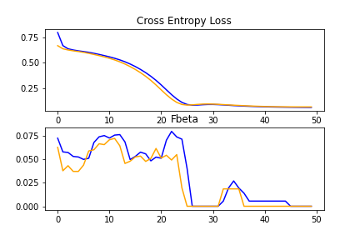

Slide 12
Distance
Create spectrogram of each audio sample
Use Generators to feed the deep learning model
Use a CRNN model for predictions.
Notes:
Generators - generate a dataset on multiple cores in real time and feed it to the deep leaning model
You define dimensions, if you need to shuffle, things like that
CRNN - convolutional recurrent neural network.
First we found it in a paper by Mariam Yiwere and Eun Joo Rhee, titles “Sound Source Distance Estimation Using Deep Learning: An Image Classification Approach”. The proposed network is supposedly better towards audio signal processing.

Slide 13
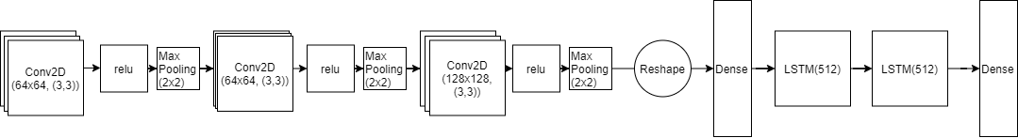

Slide 14
CRNN results
Better than a coin flip! (Barely)

Slide 15
Conclusion
Created 3 models for two different tasks
Explained how we recorded audio
Explained audio theory
Notes:
In the Blog, you can also see further research into Noise Removal.

Slide 16
Thank you !

